Slide 1
SUSTAINABLE GREEN CAMPUS: ASIAN UNIVERSITY
AS A CASE STUDY
NG XIN YI
JEONG YE JIN
SASAKI RYOTA
CHU ZHAO HAN
RIDZWAN SHAHRIL
MATSUMOTO SUZUNA
-GROUP 2-

Slide 2
Contents
What is Green Campus???
Criteria & indicators for a green and sustainable campus
Case studies
Seoul National University (Korea)
Ritsumeikan University (Japan)
Shanghai Jiao Tong University (China)
Suggestions
Summary

Slide 3
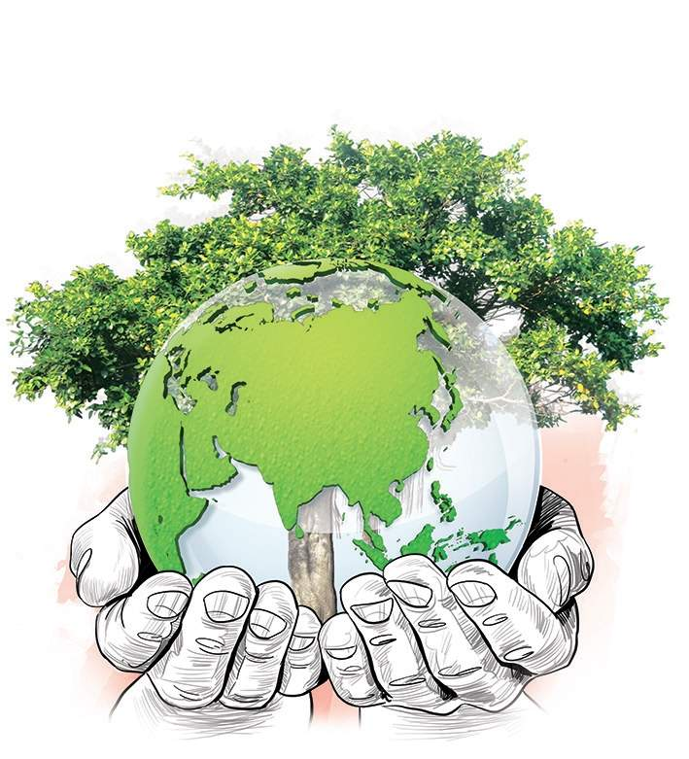
GREEN CAMPUS
Sustainable & eco-friendly
Activities under
“ Sustainable Development” vision
Notes:
A green campus is a place where environmentally responsible practice and education combine to promote sustainable and eco-friendly practices in campus. The green campus concept offers opportunity regarding to sustainable solutions on environmental, social and economic need of man

Slide 4
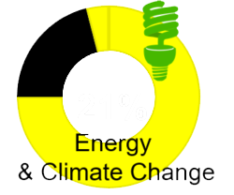
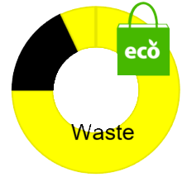
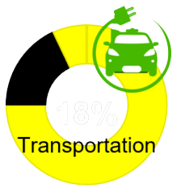
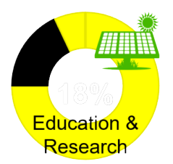
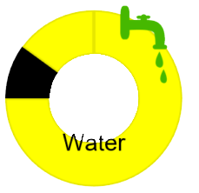
Criteria & Indicators for a green & sustainable campus

Slide 5
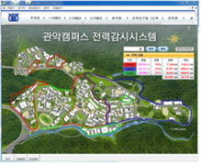
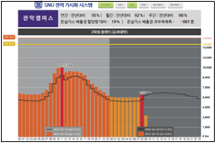
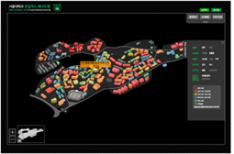
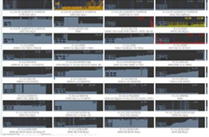
Seoul National University
Energy Visualization Through Energy Usage Monitoring
power monitoring system
Electricity visualization system
Greenhouse gas monitoring System
Symptom detection system

Slide 6
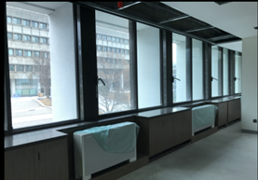
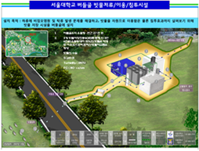
Seoul National University
2. Eco-friendly Campus
Insulation reinforcement facility
Improve air-conditioning & heating facilities
Improve lighting environment
Reduce water consumption & water resources
Executive Interior Window
Remodeling
Green Large Rainwater Storage Facility Installation Status

Slide 7
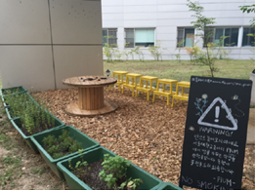
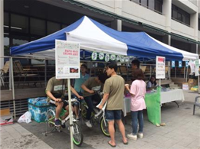
Seoul National University
3. Green Campus Student Activities Support
Support Student Organizations
GHGs Energy Infographic Competition
25 environmental & sustainability courses
Green area project of
eco-friendly club 'Phium'
Green Campaign
Experience Booth

Slide 8
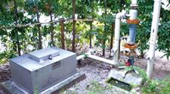
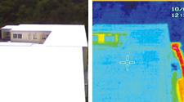
Ritsumeikan University
Activities for Green Campus
Well to use rainwater and springwater for toilet water.
Insulation coating.

Slide 9
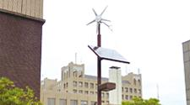
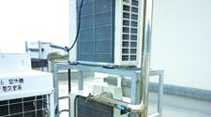
Ritsumeikan University
Activities for Green Campus
Solar and wind power generation
Water cooling for outdoor unit of air conditioner

Slide 10
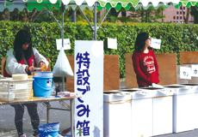
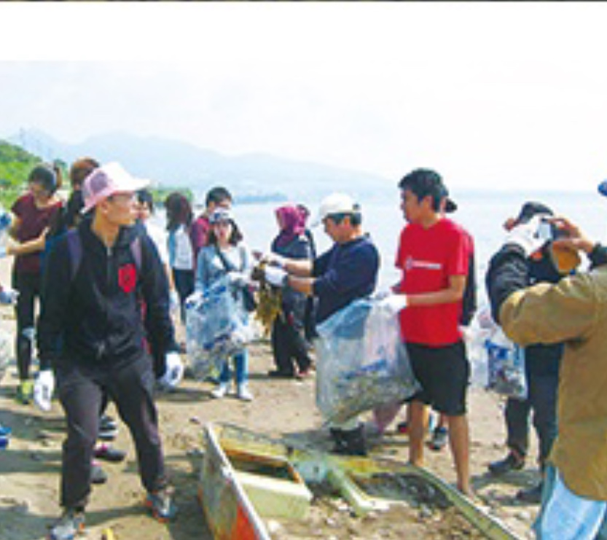
Ritsumeikan University
Sets up garbage area for recycle
pick up garbage

Slide 11
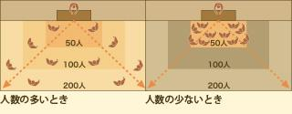
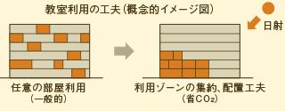
Ritsumeikan University
Energy Saving Systems
Automatic control of air conditioner and lighting in classroom.
Figure 1: MOTTINAI System
Automatic change classroom in order to improve efficiency electronic.
Figure 2: Smart lecture system

Slide 12
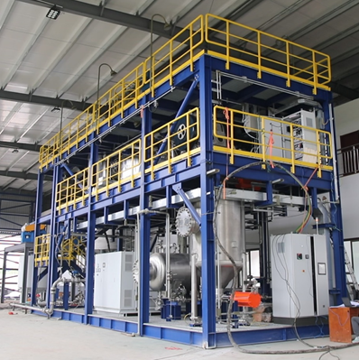
Shanghai Jiao Tong University
Hydrothermal oxidation technology of wet garbage
Concept
Under a specific high temperature and pressure environment
Being converted into high value-added products such as humic acid, formic acid, acetic acid and lactic acid
Advantages
Fast products transformation
High integration
High Economic Value
Implementation
A 100 kg pilot-scale equipment is located on the east side of the 3rd restaurant of SJTU
Notes:
We will show you two new research results of SJTU, pointing out the future development direction of garbage disposal and green building.
It can accelerate the decomposition of organic matter in wet garbage, and convert them into high value-added products such as humic acid, formic acid, acetic acid and lactic acid in a specific high temperature and high pressure environment.
Compared with anaerobic digestion technology, the product transformation speed of this technology is very fast. At the same time, it can achieve a high degree of integration, greatly reducing the area occupied by the plant, and high economic value of products.
Now, in the east of the third restaurant building of Shanghai Jiaotong University, there are still pilot-scale equipments used to treat kitchen waste produced in school canteens.

Slide 13
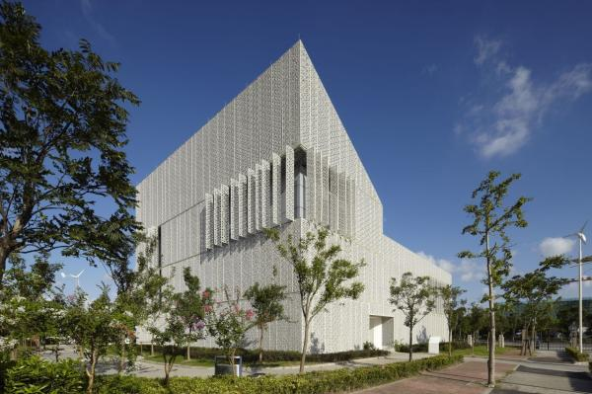
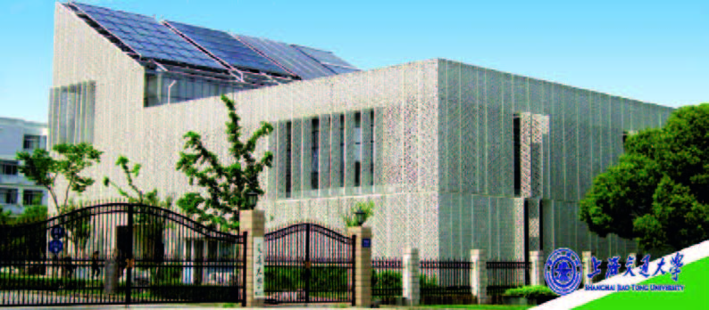
Shanghai Jiao Tong University
Sino-Italian Green Energy Lab
Architectural Structure
Insulating glass curtain inner wall & Ceramic curtain outer wall
Energy management
Over 20 green energy technologies applied
Solar energy compound air conditioning and heating system / Renewable energies power supply
Housing Model
Smart Home / Zero Energy Consumption Residential Technology
Notes:
The Sino-Italian Green Energy Building, co-financed by the Italian government and SJTU, was officially completed in 2012.
The green energy building is a white building with double wall structure. The inner layer is insulated glass curtain wall and the outer layer is ceramic curtain wall.
It can effectively block the direct sunshine in summer, and better lighting in winter, so as to play an effective role in energy saving and energy utilization.\
There are many kinds of solar air-conditioning and ice-making systems in the energy building, as well as more than 20 energy-saving technologies, such as biomass power generation, wind and light complementary power generation, smart micro-grid, etc.
Due to the full use of renewable energy and efficient energy-saving equipment, the whole building can operate independently from the central grid, and even output electricity.
The green energy building provides a smart home model room. Through remote control and automatic perception, it can satisfy the comfort of the home and save resources to the greatest extent.

Slide 14
-Suggestions on developing a green campus-
Low Carbon Effort - product, building and transportation
Ecolabeling
Recycled & eco-friendly material
Design concept
Electric bus
Notes:
For low carbon effort, we can have 3 aspects which are product building and transportation. First, we suggest university can use product that has ecolabeling or sustainability certification. Some examples are Energy Star and Green Seal. next, we suggest that university can use recycled or eco-friendly materials in constructing a building. Besides, we can design a building that can maximize incoming natural light during daytime so we can save energy. Another suggestion for transportation is to invest in electric buses and bikes to promote low carbon on campus.

Slide 15
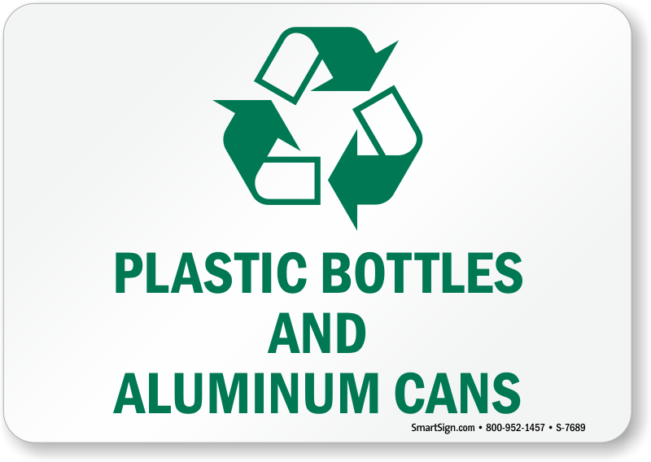
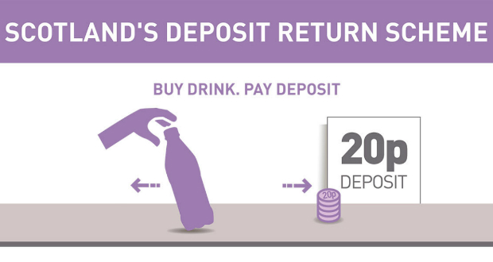
-Suggestions on developing a green campus-
Waste management - Deposit system
Buy drinks
Pay deposit
Get back deposit by returning back bottles
Notes:
Next, we will talk about waste management. University should introduce deposit system. Please look at right picture. It is scotland’s example.

Slide 16
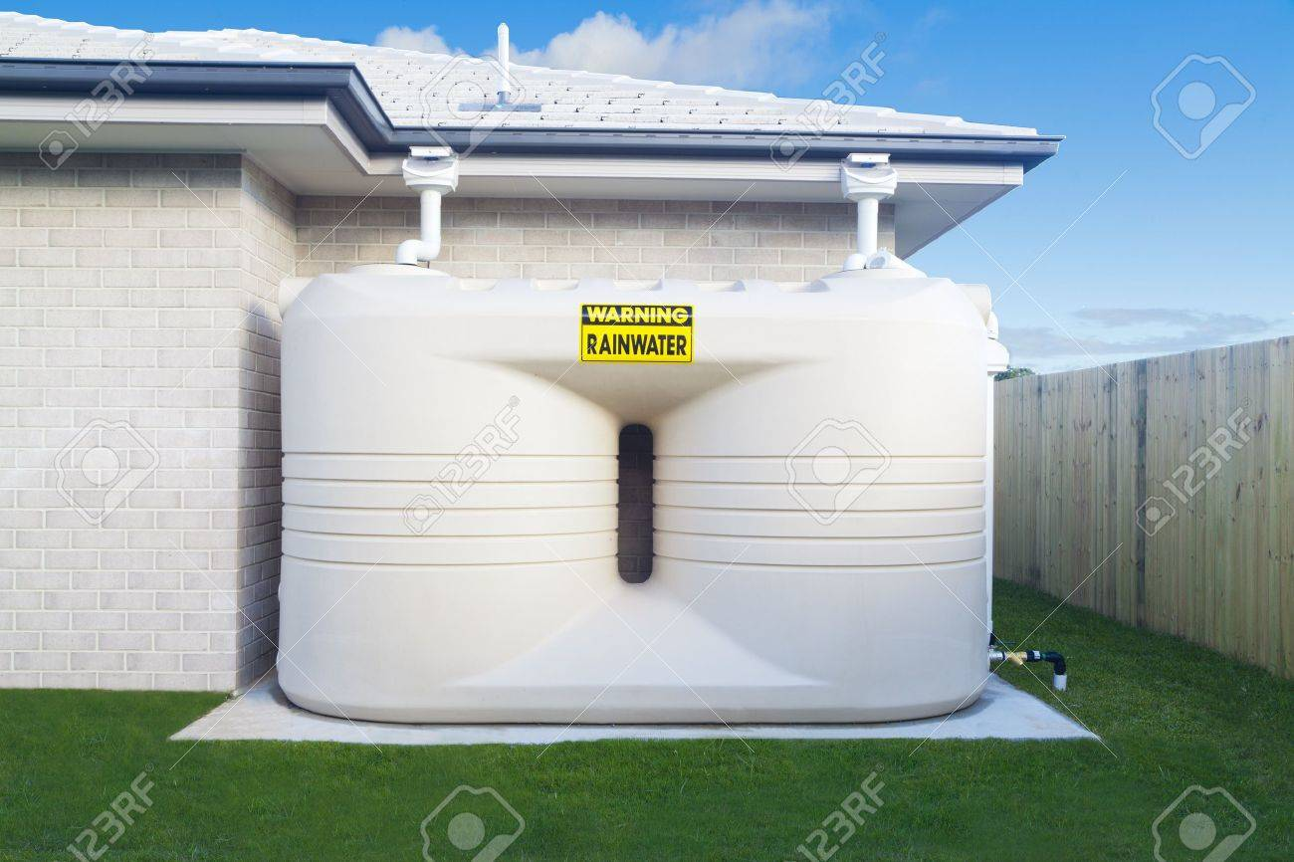
-Suggestions on developing a green campus-
Water - saving water for
plant
toilet
disaster
Notes:
Next suggestion is about water. Please look at this picture. This is rain water tank. We use it for saving water. We can use this water for growing plants, toilet and disaster.

Slide 17
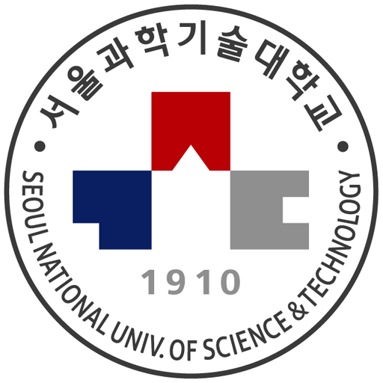
THANK YOU!!!

